Slide 1


Social Buzz
- Top Category Analysis

Slide 2


Today's agenda
Project recap
Problem
The Analytics team
Process
Insights
Summary

Slide 3

Social Buzz is a fast-growing technology unicorn that needs to adapt quickly to its global scale.
Accenture has begun a 3 month POC focusing on these tasks:
Project Recap
An audit of Social buzz big data practice
Recommendation for successful IPO
Analysis to find Social Buzz’s top 5 most popular categories of content

Slide 4


Problem
Over 100000 posts per day
36,500,000 pieces of content per year!
But how do we capitalize on it when there is so much?
Analysis to find Social Buzz’s top 5 most popular categories of content

Slide 5



Andrew Fleming
Chief Technical Architect
The Analytics team
Marcus Rompton
Senior Principal
Nivetha Ramesh
Data Analyst

Slide 6
Process
1
Data Understanding
2
Data Cleaning
3
Data Modelling
4
Data Analysis
5
Uncover Insights

Slide 7
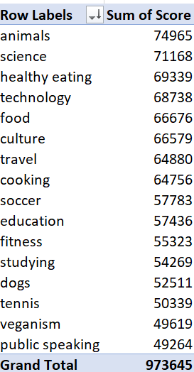

Insights
Top 5 Categories by Sum of Scores:
Animals: 69,743
Science: 66,606
Healthy Eating: 65,084
Technology: 64,648
Food: 62,251

Slide 8

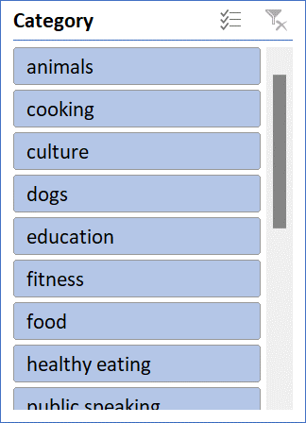
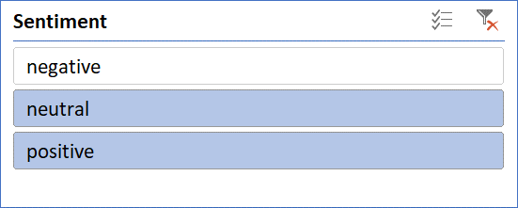
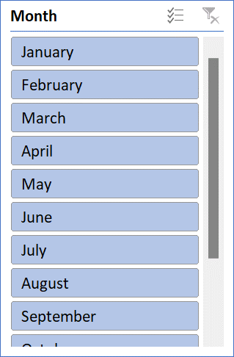
GRAND SCORE
Social Buzz - Top Category Analysis
973645

Slide 9
Recommendations
Focus on Top Categories: Prioritize content creation in Animals, Science, Healthy Eating, Technology, and Food
Enhance Engagement: Develop interactive content such as quizzes and polls within these categories to boost engagement.
Monitor Trends: Regularly analyze data to identify emerging trends and adjust content strategy accordingly.

Slide 10

Top Categories Identified:
Animals, Science, Healthy Eating, Technology, Food
Trend Monitoring: Regularly analyze data to stay updated on audience preferences.
Partnerships: Collaborate with influencers and experts to enhance reach and credibility.
Summary

Slide 11

Thank you!
ANY QUESTIONS?

